Slide 1
CS210
Algorithms and Data Structures
Introduction to MonteCarlo Simulation
Week 10
Semester 1 2025
Dr. Pierpaolo Dondio

Slide 2

Week 10
Motivation
Definition and key properties of MM simulation
Example of Applications
Java Implementation(s)

Slide 3
Why MM simulations?
Remember heuristics?
We are not interested in finding the exact solution, we are interested in approximating it and understand how far we are from the actual solution
Some problems might not have an explicit solution (or we have not solved them yet)
Some problems have a solution, but it is too hard to compute
Montecarlo simulations are useful in these cases

Slide 4
Definition of MM simulation
Monte Carlo Simulation is a computational technique that uses random sampling to estimate numerical results.
Key points:
It is used when analytical solutions are difficult or impossible.
It relies on repeated random experiments to approximate probabilities, averages, or other statistical quantities.
The accuracy of the estimate improves with the number of simulations.
Common applications include:
  Estimating areas or integrals
  Probabilities in games of chance
  Risk assessment in finance and engineering
  Simulating complex systems with randomness

Slide 5
Basics
System: The physical process of interest
Model: Mathematical representation of the system
  Models are a fundamental tool of science, engineering, business, etc.
  Abstraction of reality
  Models always have limits of credibility
Simulation: A type of model where the computer is used to imitate the behavior of the system
Monte Carlo simulation: Simulation that makes use of internally generated (pseudo) random numbers

Slide 6
Ways to Study System
System
Experiment w/ actual system
Experiment w/ model of system
Physical
Model
Mathematical
Model
Analytical
Model
Simulation
Model
Our Focus

Slide 7
Advantages of Simulation
Often the only type of model possible for complex systems
  Analytical models based on exact solution frequently infeasible
Process of building simulation can clarify understanding of real system
  Sometimes more useful than actual application of final simulation
Allows for sensitivity analysis and optimization of real system without need to operate real system
Can maintain better control over experimental conditions than real system
Time compression/expansion: Can evaluate system on slower or faster time scale than real system

Slide 8
Some Disadvantages of Simulation
May be very expensive and time consuming to build simulation
Easy to misuse simulation by “stretching” it beyond the limits of credibility
  Problem especially apparent when using commercial simulation packages due to ease of use and lack of familiarity with underlying assumptions and restrictions
  Slick graphics, animation, tables, etc. may tempt user to assign unwarranted credibility to output
Monte Carlo simulation usually requires several (perhaps many) runs at given input values
  Contrast: analytical solution provides exact values

Slide 9
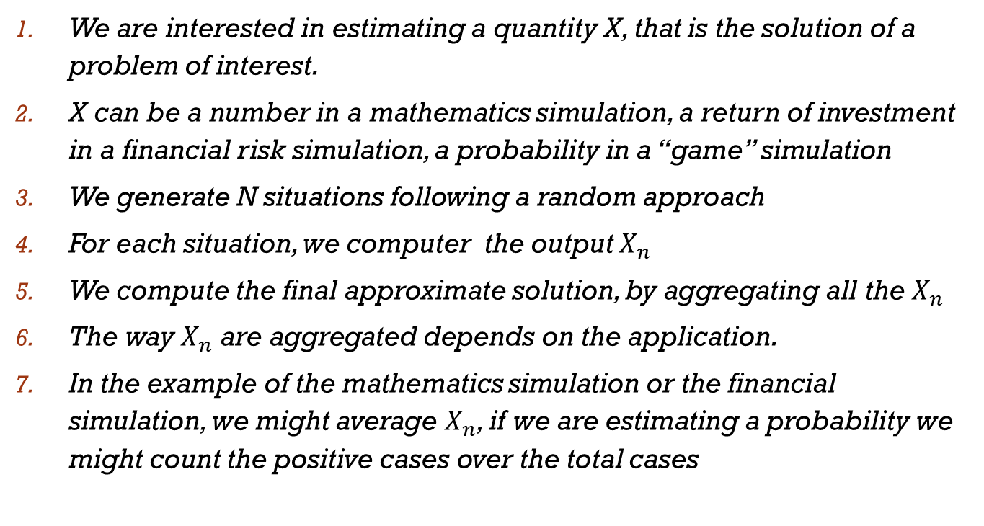
Basic Approach

Slide 10
Example
What is the probability to get a poker at Texas Hold’em poker?
Select the number of simulations N (=trials)
Repeat N times:
  Shuffle the deck (randomness is here!)
  Pick 7 cards
  Check if there is a poker
Count all the times a poker was present, call it P
The final probability is P / N (positive cases divided by the total number of cases)

Slide 11
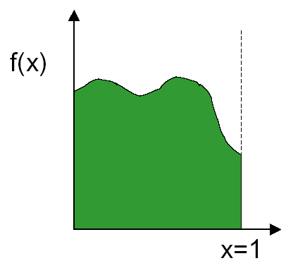
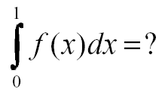
Example: integral of a function
How to evaluate the integral of f(x)?
For some integrals there is no solution, only an estimated value…

Slide 12
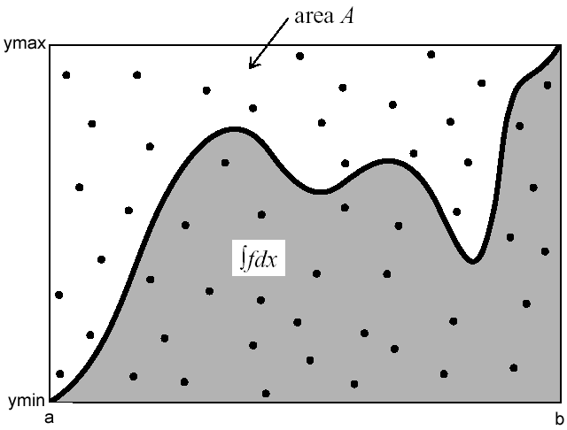
Example: integral of a function
Idea: generate random points and check how many are below the curve of the function (grey area)
Estimate the area based on the portion of points in the grey area

Slide 13
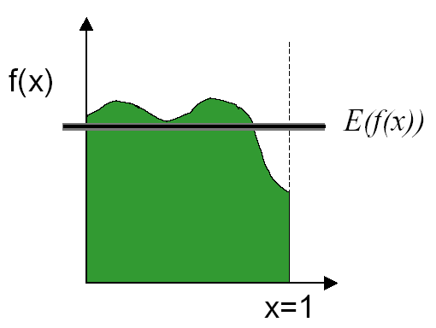
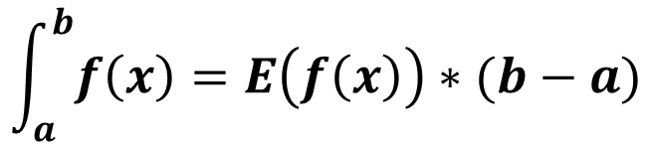
Another possible MM approach
We can approximate by taking the average or the expected value
a b

Slide 14
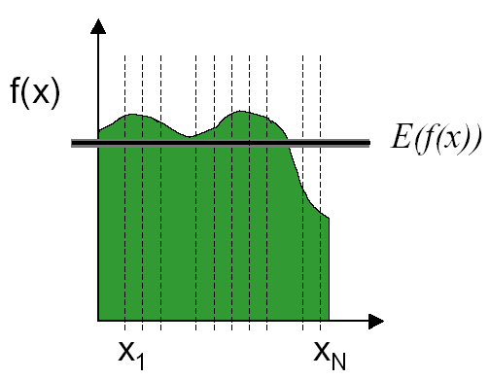
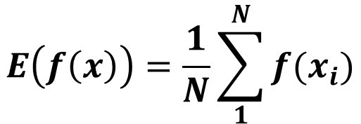
Estimate the average E(f(x))
We can estimate the average E(f(x)) using MM simulation
We take N points and we average them to estimate E(f(x))

Slide 15
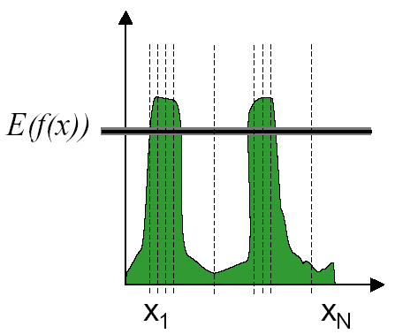
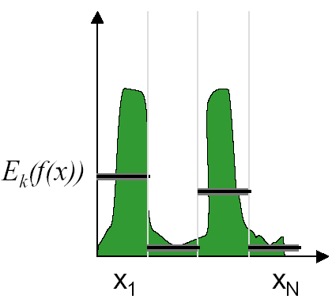
A better way of sampling
Instead of creating sample simulation completely random, there are other ways that can reduce the error of the simulations
Important Sampling: Sample more in the functions have more important values
Stratified Sampling: Partition the range of data into smaller domains intervals and apply MM simulation to each of them

Slide 16
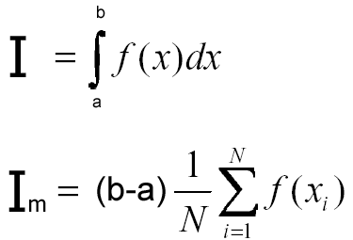

MonteCarlo integration
I_{m} = Monte Carlo estimate
N = number of samples
x₁, x₂, …, x_{N} are uniformly distributed random numbers between a and b
The more simulations, the better is the estimate

Slide 17
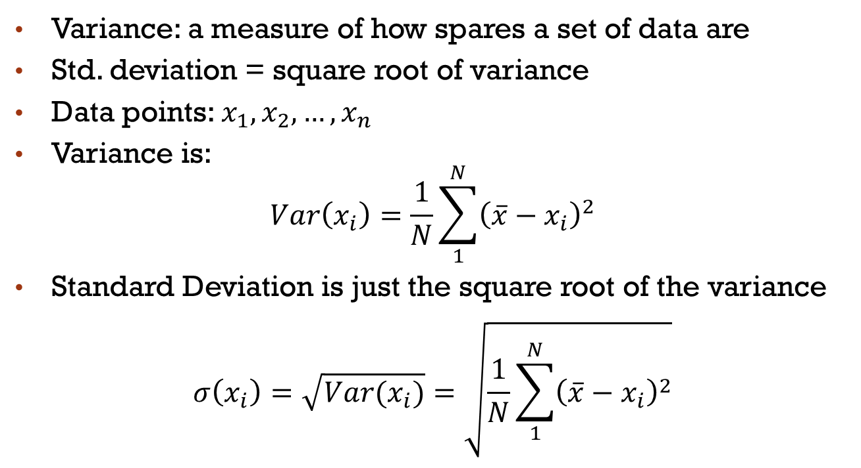
Recap: variance and std. deviation

Slide 18
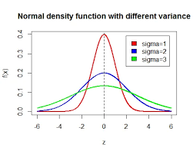
Variance
What set of points have higher variance? (the mean is the same)
mean
mean

Slide 19
How many samples do we need?
Each time we rerun the Monte Carlo we get different results due to the inherent randomness
How much confidence can we put on our estimates? How many samples do we need?
Intuitions: the more sample, the surer about our estimate we are
It also depends how different are the outputs of each simulation (=the variance of the simulations).
  If they are pretty close to each other, we are more confident and we might need less trials
  If they change dramatically, we might need more trials to be confident

Slide 20
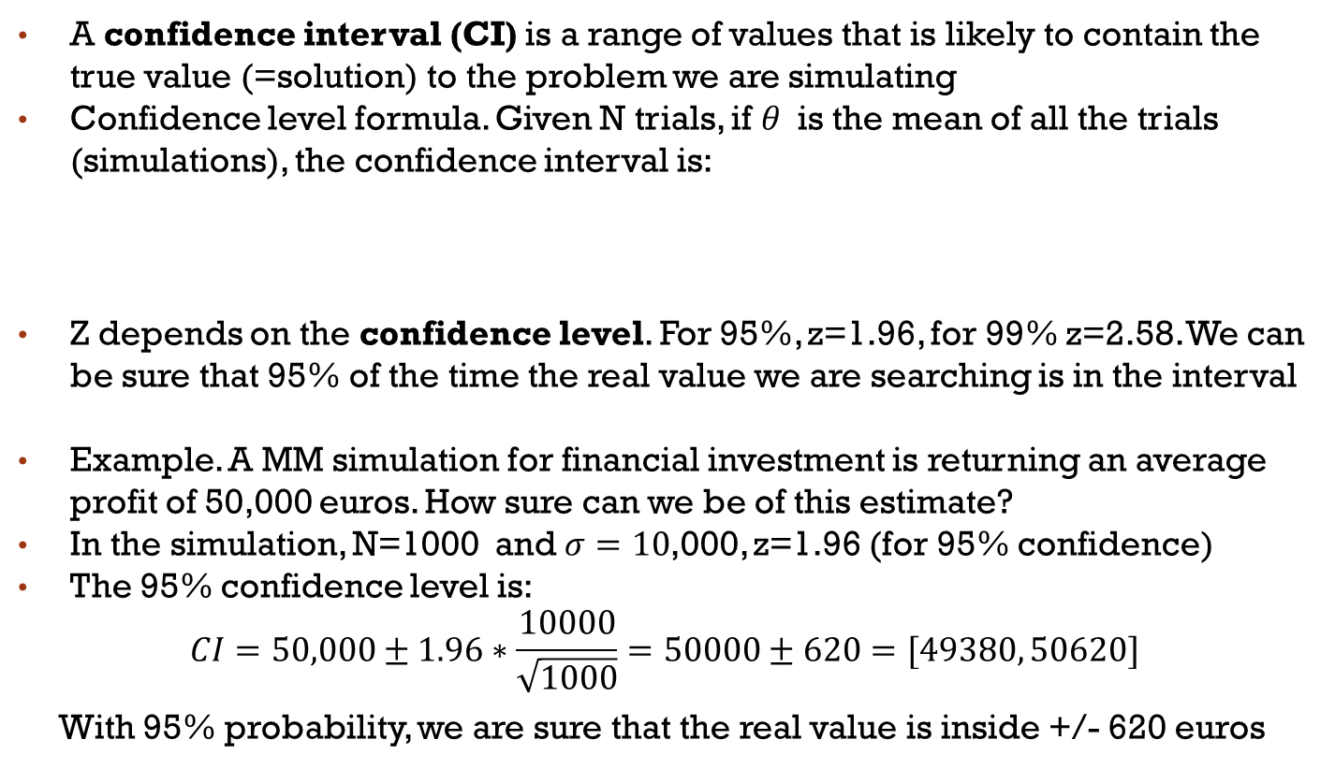

Confidence interval

Slide 21
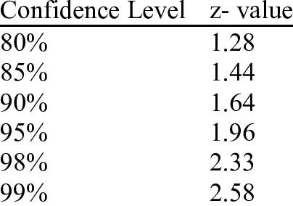
Values of z by confidence level

Slide 22
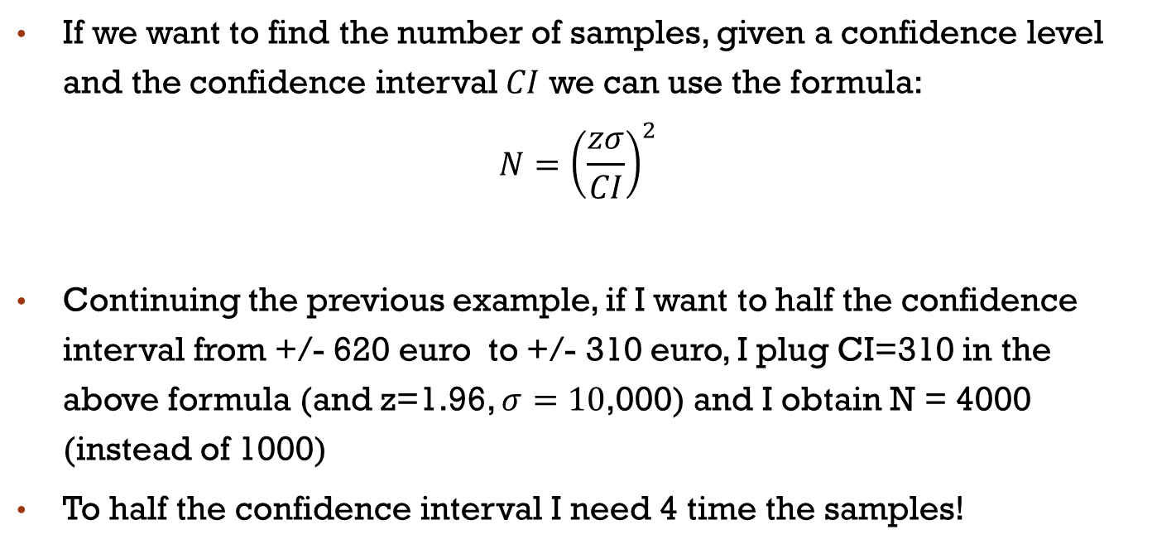
Confidence interval and variance

Slide 23
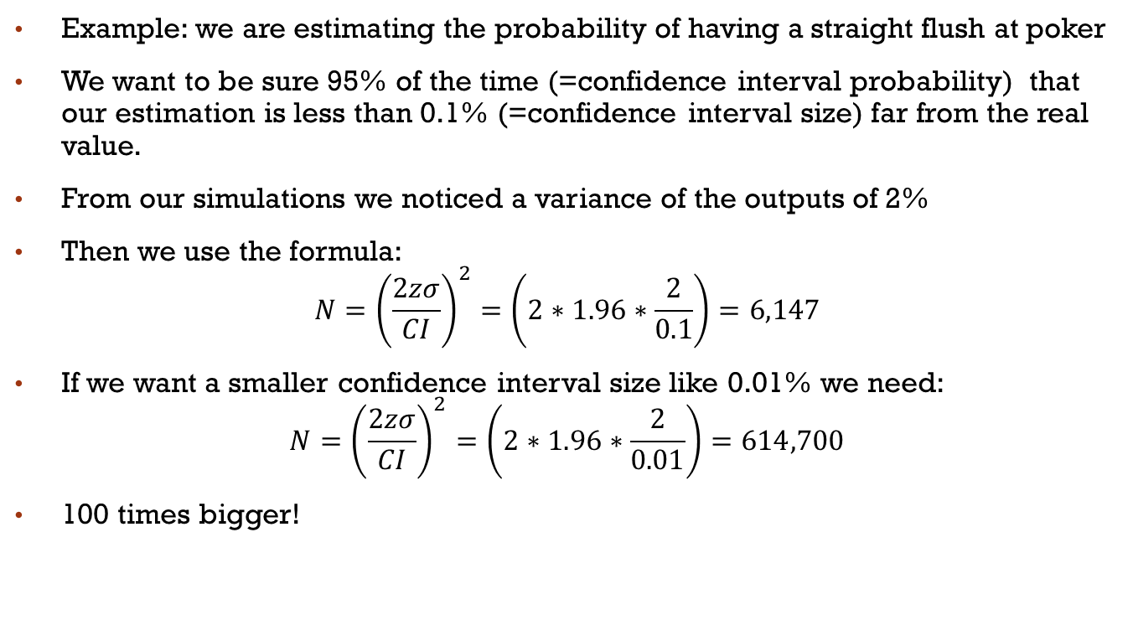
Example /2

Slide 24
MM Simulation Examples
Greek PI
Throw 10 dices and get number 25
Probability of getting a 4-of-a-kind at Poker

Slide 25

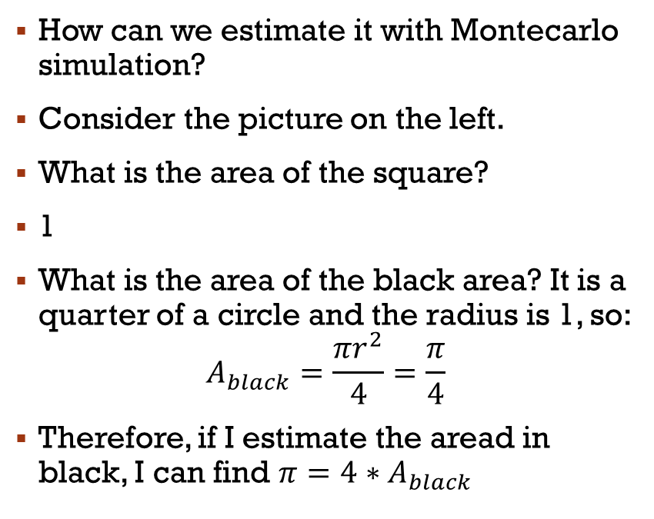
1
1,1
0
1

Slide 26

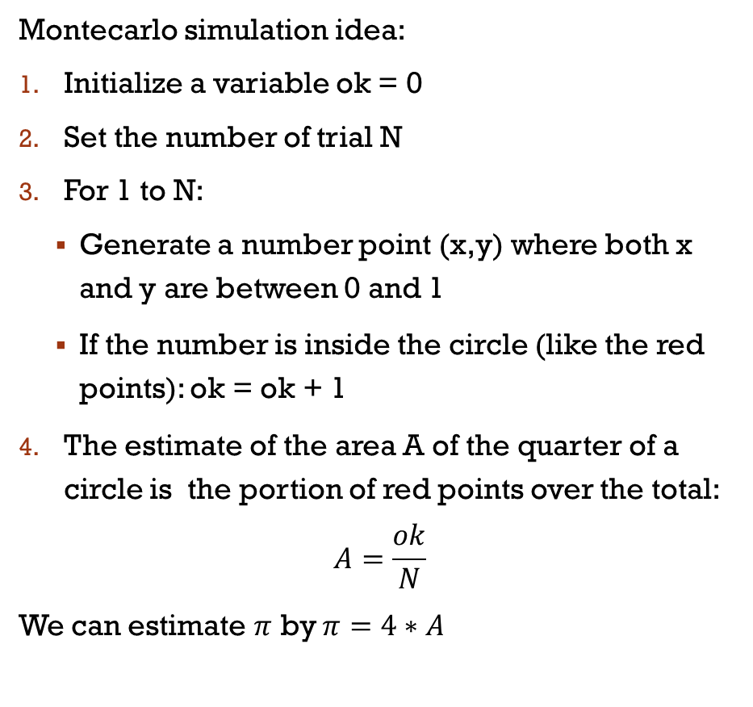
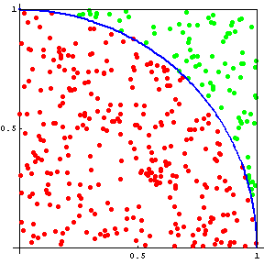

Slide 27
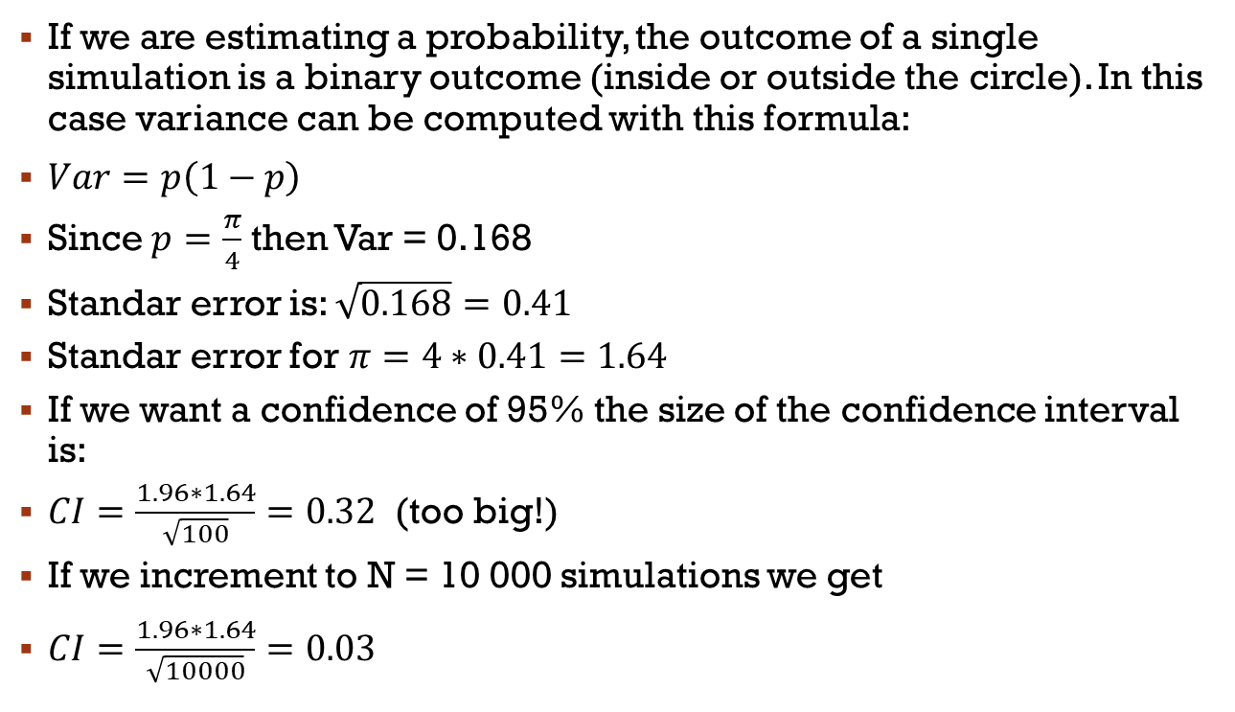
CONFIDENCE INTERVAL

Slide 28
Probability to throw Dice
What is the probability of getting 25 by throwing 10 dices?
  Roll ten 6 sided die N times.
  Compute the sum of all the dice
  Count the number of time you get a 25, call it count_25
  Estimate the probability as count_25/N.

Slide 29

Probability of a Straight Flush
What is the probability of being dealt a straight flush in a 5 card poker hand?
  Generate N 5 card poker hands.
  Count how many are a straight flush - call count_sf
  Estimate the probability as count_sf/N.
  Remember that the Ace can be used as a 1 or as the highest card (after the King): A,2,3,4,5 is a straight and also 10,J,Q,K,A is a straight

Slide 30
How Randomess is generated in computers?

Slide 31
Random versus Pseudo-random
Virtually all computers have “random number” generators
Their operation is deterministic, it is not based on chance
Sequences are predictable
More accurately computer generates “pseudo-random number”
“RNG” means “random number generator”

Slide 32
Properties of an Ideal RNG
Uniformly distributed
Uncorrelated
Never cycles
Satisfies any statistical test for randomness
Reproducible
Machine-independent
Changing “seed” value changes sequence
Easily split into independent subsequences
Fast
Limited memory requirements

Slide 33
No RNG Is Ideal
Finite precision arithmetic ⇒ finite number of states ⇒ cycles
  Period = length of cycle
  If period > number of values needed, effectively acyclic
Reproducible ⇒ correlations
Often speed versus quality trade-offs

Slide 34
Linear Congruential RNGs
Modulus
Additive constant
Multiplier
Sequence depends on choice of seed, X₀

Slide 35
Period of Linear Congruential RNG
Maximum period is M
For 32-bit integers maximum period is 2³², or about 4 billion
This is too small for modern computers
Use a generator with at least 48 bits of precision

Slide 36
Producing Floating-Point Numbers
X_{i}, a, c, and M are all integers
X_{i}s range in value from 0 to M-1
To produce floating-point numbers in range [0, 1), divide X_{i} by M

Slide 37
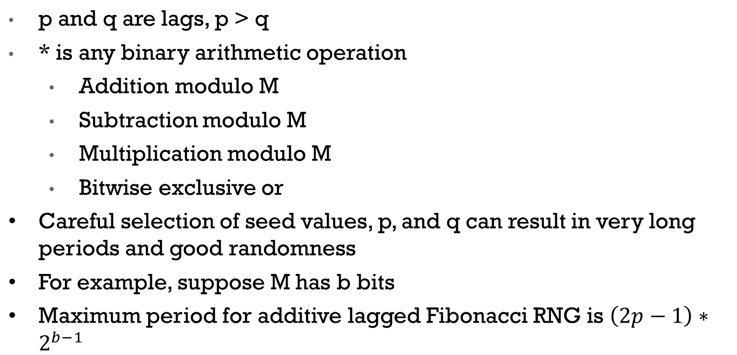
Lagged Fibonacci RNGs

Slide 38
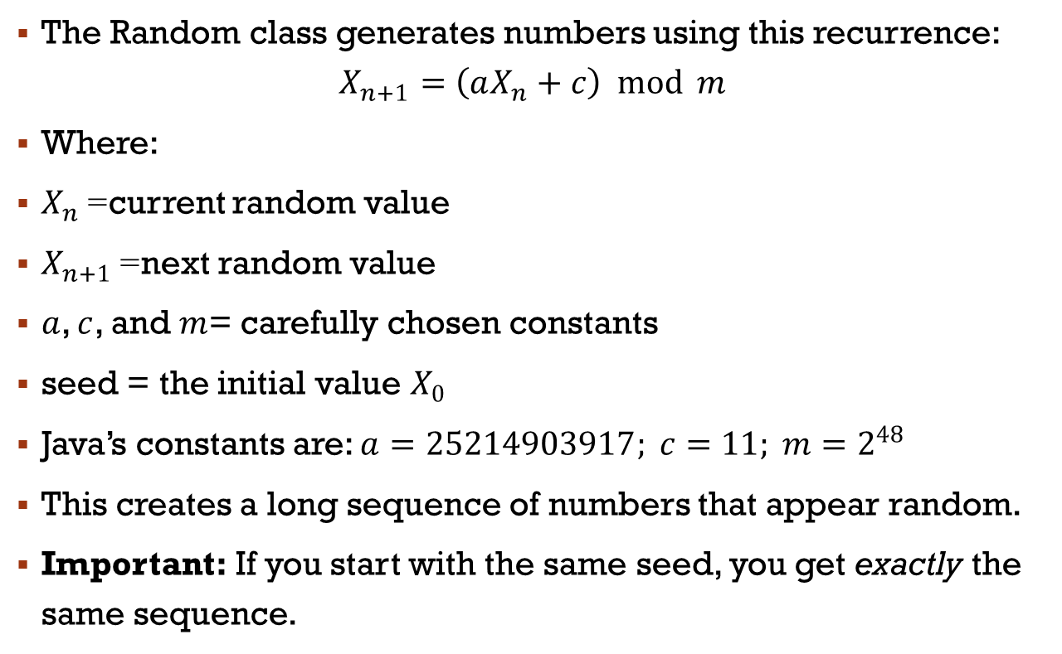
Random number in java

Slide 39
Randomness in JavA
Randint()
Usueful data structure: ArrayList
Shuffle randomly an array (ArrayList)

Slide 40
The random java class
The Random class allow to generate random numbers.
The object is initialized with:
Random rand = new Random(seed); (seed in an integer)
Method | Returns | Typical Use
nextInt() | any int | general randomness
nextInt(bound) | int 0 to bound–1 | dice, indexes, cards
nextDouble() | double 0–1 | Monte Carlo weighting
nextBoolean() | true/false | random choices
nextFloat() | float 0–1 | graphics/games
nextLong() | any long | large random numbers
nextGaussian() | normal distribution | scientific simulations
setSeed(seed) | void | reproducible randomness
nextBytes(arr) | void | random data blocks

Slide 41
Arraylist in java
Dynamic arrays (based on linked lists..)
import java.util.ArrayList;
Unlike regular arrays (int[] arr), an ArrayList can:
  Grow or shrink automatically
  Store objects (not primitives)
  Provide many useful methods for insertion, removal, searching, etc
ArrayList<String> names = new ArrayList<>();
Method | Meaning | Example
add(value) | Add element to end | list.add("Bob");
add(index, value) | Insert at position | list.add(1, "Alice");
get(index) | Read element | list.get(0);
set(index, value) | Modify element | list.set(0, "Tom");
remove(index) | Remove by index | list.remove(2);
remove(Object) | Remove first matching value | list.remove("Bob");
size() | Number of items | list.size();
contains(x) | Check existence | list.contains("Bob");
clear() | Remove all elements | list.clear();
To shuffle an ArrayList, use the shuffle() method of the class Collections (see demo ArrayList in java)

Slide 42

Java demos
RandomTest.java
ArrayListDemo.java
FourOfAKindMonteCarlo.java
  MM simulation to find the probability to get a 4-of-a-kind at Texas Hold’em
  The exact solution (from maths) is about 0.168% (1 over 594):
RandomTest.java
ArrayListDemo.java
MonteCarloPI.java
DiceMonteCarloCI.java

